Slide 1
The value of internet video calling and desktop sharing (VCDS) as a research method
Dr Elizabeth Hidson
Senior lecturer, university of Sunderland

Slide 2
Background to the study
2014: Computer Science replaces former ICT curriculum in schools
Teachers’ relative subject knowledge deficits
Shulman’s PCK construct (1986) – the ‘teachability’ factor

Slide 3
Teachers’ Knowledge Bases
Pedagogical Content Knowledge (PCK)
Subject Matter Knowledge
Curricular Knowledge
…
…
(Shulman, 1986)

Slide 4
Pedagogical Reasoning Process
Comprehension
Transformation
Instruction
Evaluation
Reflection
(Shulman 1987)

Slide 5
Transformation
Preparation
Representation
Instructional selection
Adaptation
Tailoring
(Shulman 1987)

Slide 6
Research Questions
How are teachers planning Computing lessons?
How is pedagogical content knowledge (PCK) demonstrated in the planning process?
How is the Computer Science subject knowledge requirement being addressed by different teachers?

Slide 7
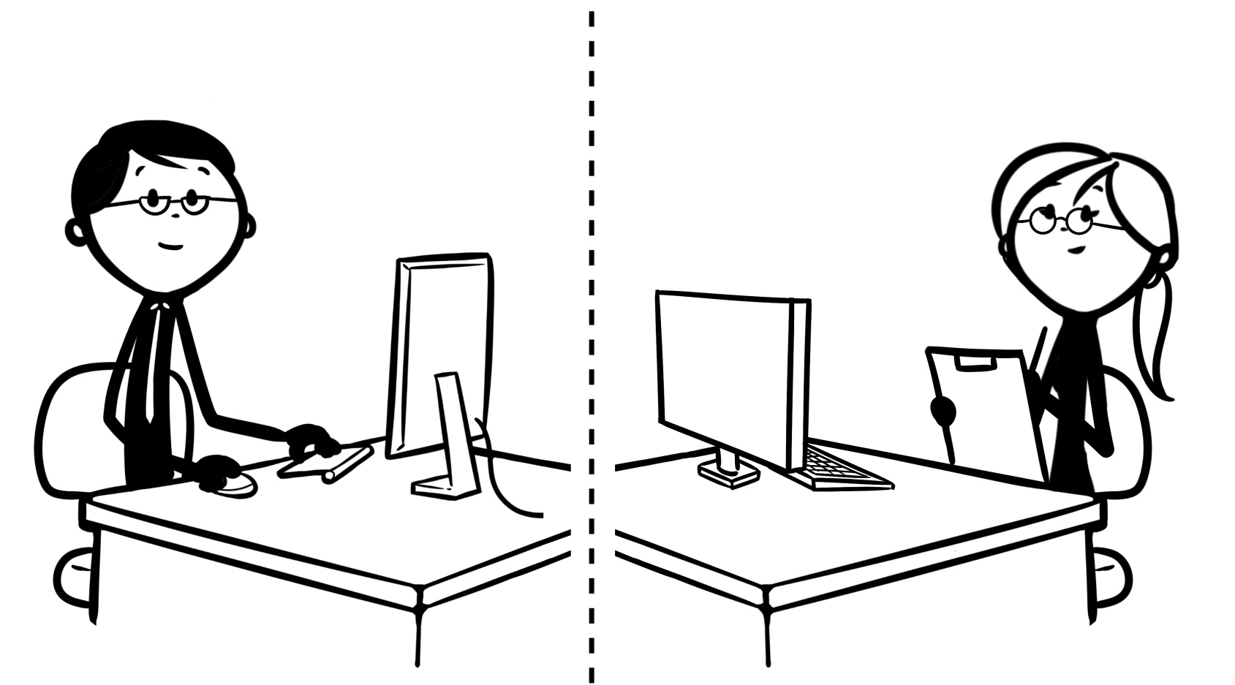
Data Collection Methods

Slide 8
Example Skype Shared Desktop

Slide 9
Video-Stimulated Interviews

Slide 10
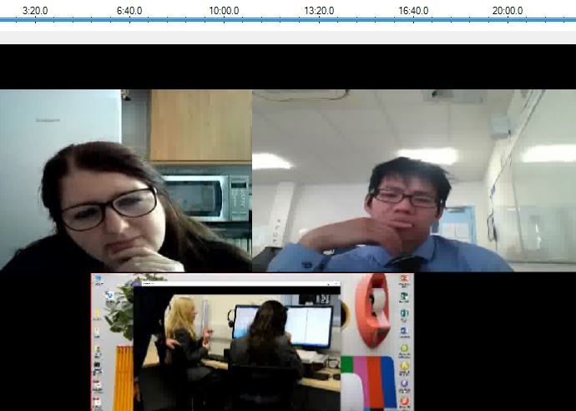
1. Researcher
Video Stream
2. Participant
Video Stream
3. Participant Desktop
Stream

Slide 11
What does the literature say?
collect, collate and interpret the practical knowledge of teachers (Shulman, 1987)
a methodology capable of generating insight into intrasubjective processes (Dempsey, 2010)
‘see’ things more clearly through a visual methodology, allowing a ‘new view’ with the luxury of meta-analysis and reflection (Lyle, 2003)
rich focus on the minutiae (Weller, 2015)
reflection-on-action; reflection-in-action (Schön 1991)
shared reflective, dialogic experience between researcher and participant (Jones et al., 2009)
read the pedagogical environment critically (Nind et al., 2015)

Slide 12
“A methodological frontier…”
Weller (2015)

Slide 13
Model of desktop sharing method
Hidson (2018)

Slide 14
Case Study 1
The dialogic interview

Slide 15
Case Study 2
The think-aloud interview

Slide 16
Affordances
creating lesson artefacts and resources
locating saved materials for re-use or review
use of internet search engines to locate text or multimedia information
trialling methods for use in the classroom: developing programming techniques in advance of teaching
illustrating something referred to by locating it in their own archives or on the internet
What did this research environment and shared digital space offer us access to in this study?

Slide 17
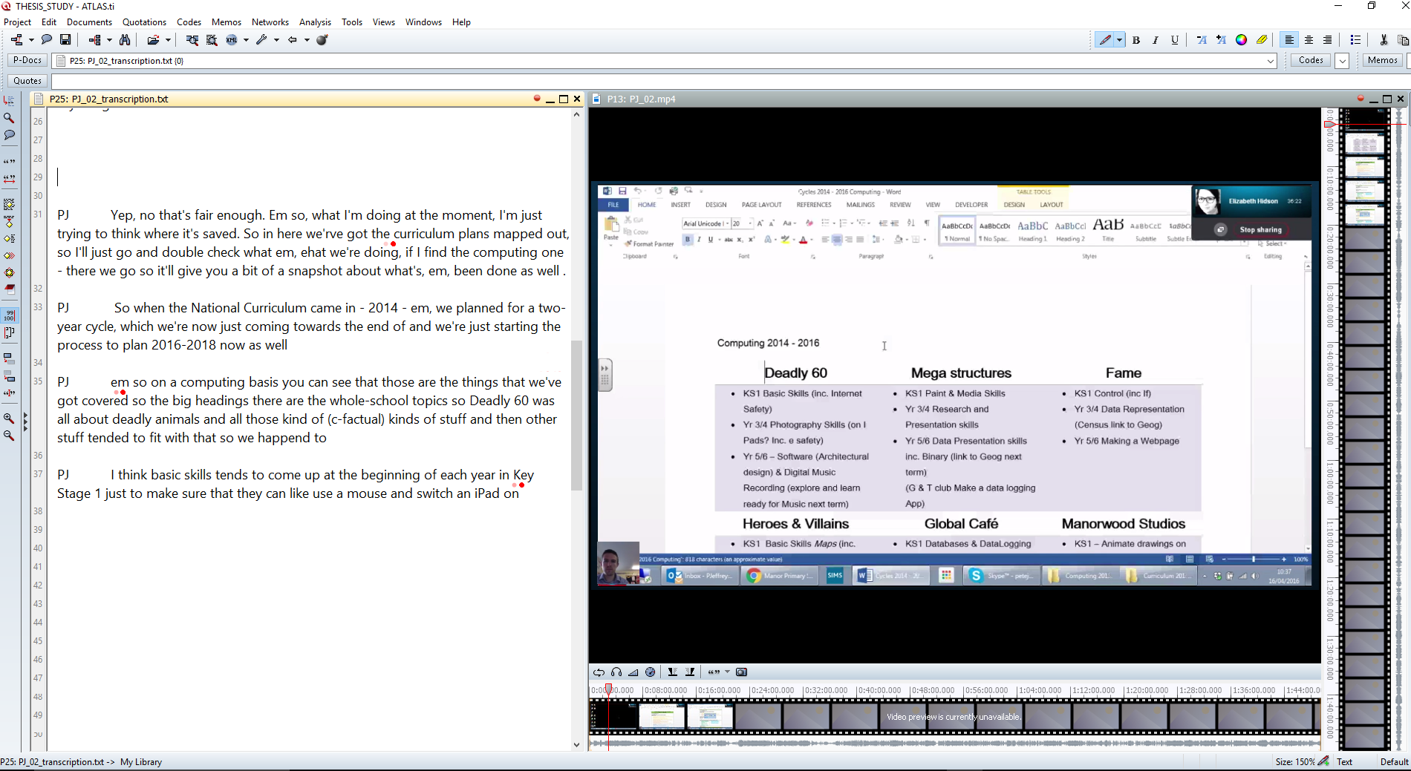
Limitations and implications
Transcribing complexity: multimodal versus orthographic
Small and intense research space
A ubiquitous tool being used widely but perhaps bluntly
Limited attention in the literature to this specific approach – a few references in more recent online research methods
Technological competence of researcher and participant

Slide 18
Building a framework for using VCDS
Purpose
What can be discovered through this research experience?
What can be achieved in this session?
Technology
Technical considerations
Software features
Affective
Roles
Rapport
Etiquette
Ethics
Methodological
Relate methodology to purpose
Research design issues
Can methods be neutral?
Affordances – what can the technology do?

Slide 19
Questions/comments?
For you: examples where you could see added value through the use of VCDS as a selected research method? In my case, exploring pedagogical reasoning in action, suddenly a topic of interest for the EEF Teacher Choices trials:
- we have identified that teachers and headteachers are also keen for EEF to answer research questions which can more directly feed into existing teaching practice. These questions are often not related to the impact of manualised programmes, which require schools to purchase particular resources or training, but are instead about the everyday choices that teachers have to make when planning their lessons and supporting their students.
Questions for me?

Slide 20
Elizabeth Hidson
Elizabeth.Hidson@sunderland.ac.uk
@drhidson

